Slide 1
Appendix C: BSD UNIX

Slide 2
Appendix C: BSD UNIX
UNIX History
Design Principles
Programmer Interface
User Interface
Process Management
Memory Management
File System
I/O System
Interprocess Communication

Slide 3
UNIX History
First developed in 1969 by Ken Thompson and Dennis Ritchie of the Research Group at Bell Laboratories; incorporated features of other operating systems, especially MULTICS
The third version was written in C, which was developed at Bell Labs specifically to support UNIX
The most influential of the non-Bell Labs and non-AT&T UNIX development groups — University of California at Berkeley (Berkeley Software Distributions - BSD)
4BSD UNIX resulted from DARPA funding to develop a standard UNIX system for government use
Developed for the VAX, 4.3BSD is one of the most influential versions, and has been ported to many other platforms
Several standardization projects seek to consolidate the variant flavors of UNIX leading to one programming interface to UNIX

Slide 4
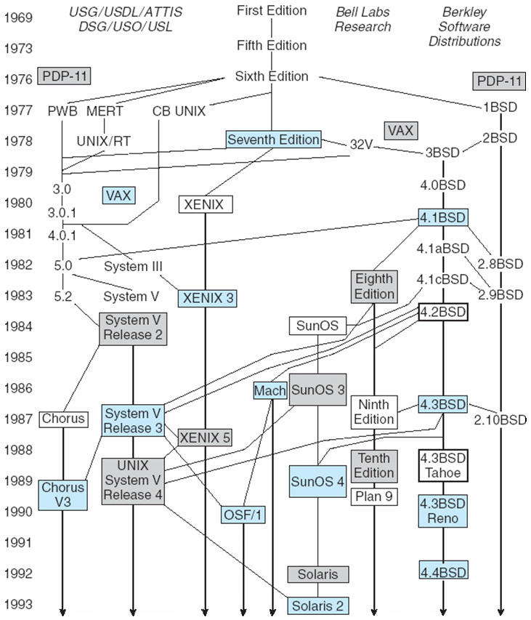
History of UNIX Versions

Slide 5
Early Advantages of UNIX
Written in a high-level language
Distributed in source form
Provided powerful operating-system primitives on an inexpensive platform
Small size, modular, clean design

Slide 6
UNIX Design Principles
Designed to be a time-sharing system
Has a simple standard user interface (shell) that can be replaced
File system with multilevel tree-structured directories
Files are supported by the kernel as unstructured sequences of bytes
Supports multiple processes; a process can easily create new processes
High priority given to making system interactive, and providing facilities for program development

Slide 7
Programmer Interface
Like most computer systems, UNIX consists of two separable parts:
Kernel: everything below the system-call interface and above the physical hardware
Provides file system, CPU scheduling, memory management, and other OS functions through system calls
Systems programs: use the kernel-supported system calls to provide useful functions, such as compilation and file manipulation

Slide 8
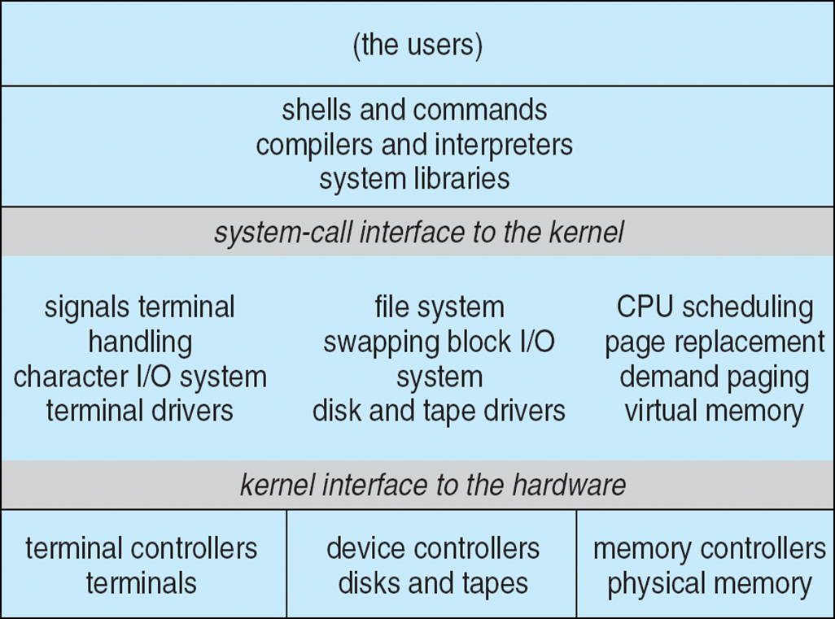
4.4BSD Layer Structure

Slide 9
System Calls
System calls define the programmer interface to UNIX
The set of systems programs commonly available defines the user interface
The programmer and user interface define the context that the kernel must support
Roughly three categories of system calls in UNIX
File manipulation (same system calls also support device manipulation)
Process control
Information manipulation

Slide 10
File Manipulation
A file is a sequence of bytes; the kernel does not impose a structure on files
Files are organized in tree-structured directories
Directories are files that contain information on how to find other files
Path name: identifies a file by specifying a path through the directory structure to the file
Absolute path names start at root of file system
Relative path names start at the current directory
System calls for basic file manipulation: create, open, read, write, close, unlink, trunc

Slide 11
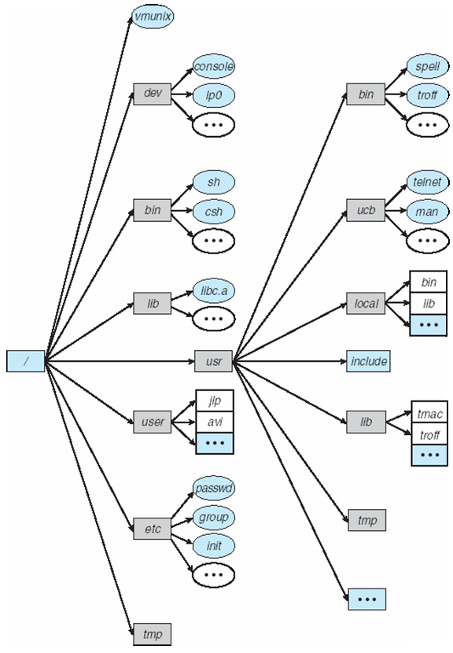
Typical UNIX Directory Structure

Slide 12
Process Control
A process is a program in execution.
Processes are identified by their process identifier, an integer
Process control system calls
fork creates a new process
execve is used after a fork to replace on of the two processes’s virtual memory space with a new program
exit terminates a process
A parent may wait for a child process to terminate; wait provides the process id of a terminated child so that the parent can tell which child terminated
wait3 allows the parent to collect performance statistics about the child
A zombie process results when the parent of a defunct child process exits before the terminated child.

Slide 13
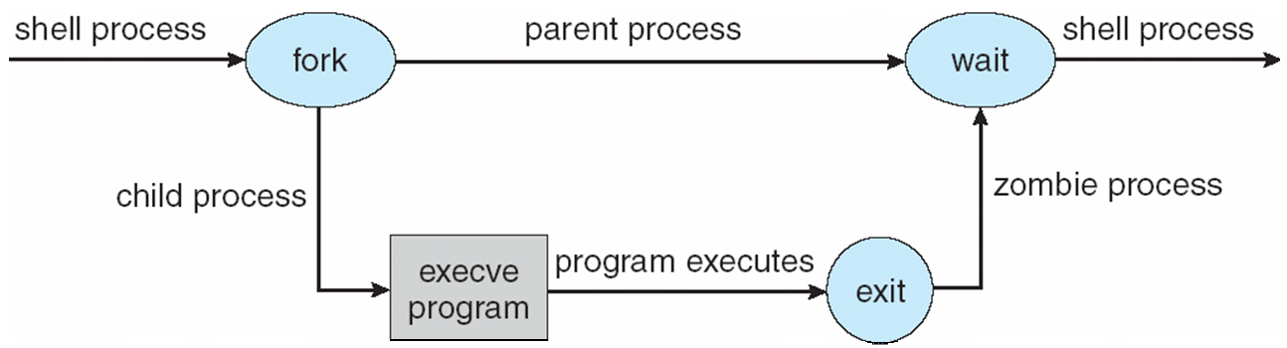
Illustration of Process Control Calls

Slide 14
Process Control (Cont.)
Processes communicate via pipes; queues of bytes between two processes that are accessed by a file descriptor
All user processes are descendants of one original process, init
init forks a getty process: initializes terminal line parameters and passes the user’s login name to login
login sets the numeric user identifier of the process to that of the user
executes a shell which forks subprocesses for user commands

Slide 15
Process Control (Cont.)
setuid bit sets the effective user identifier of the process to the user identifier of the owner of the file, and leaves the real user identifier as it was
setuid scheme allows certain processes to have more than ordinary privileges while still being executable by ordinary users

Slide 16
Signals
Facility for handling exceptional conditions similar to software interrupts
The interrupt signal, SIGINT, is used to stop a command before that command completes (usually produced by ^C)
Signal use has expanded beyond dealing with exceptional events
Start and stop subprocesses on demand
SIGWINCH informs a process that the window in which output is being displayed has changed size
Deliver urgent data from network connections

Slide 17
Process Groups
Set of related processes that cooperate to accomplish a common task
Only one process group may use a terminal device for I/O at any time
The foreground job has the attention of the user on the terminal
Background jobs – nonattached jobs that perform their function without user interaction
Access to the terminal is controlled by process group signals

Slide 18
Process Groups (Cont.)
Each job inherits a controlling terminal from its parent
If the process group of the controlling terminal matches the group of a process, that process is in the foreground
SIGTTIN or SIGTTOU freezes a background process that attempts to perform I/O; if the user foregrounds that process, SIGCONT indicates that the process can now perform I/O
SIGSTOP freezes a foreground process

Slide 19
Information Manipulation
System calls to set and return an interval timer: getitmer/setitmer
Calls to set and return the current time: gettimeofday/settimeofday
Processes can ask for
their process identifier: getpid
their group identifier: getgid
the name of the machine on which they are executing: gethostname

Slide 20
Library Routines
The system-call interface to UNIX is supported and augmented by a large collection of library routines
Header files provide the definition of complex data structures used in system calls
Additional library support is provided for mathematical functions, network access, data conversion, etc.

Slide 21
User Interface
Programmers and users mainly deal with already existing systems programs: the needed system calls are embedded within the program and do not need to be obvious to the user.
The most common systems programs are file or directory oriented
Directory: mkdir, rmdir, cd, pwd
File: ls, cp, mv, rm
Other programs relate to editors (e.g., emacs, vi) text formatters (e.g., troff, TEX), and other activities

Slide 22
Shells and Commands
Shell – the user process which executes programs (also called command interpreter)
Called a shell, because it surrounds the kernel
The shell indicates its readiness to accept another command by typing a prompt, and the user types a command on a single line
A typical command is an executable binary object file
The shell travels through the search path to find the command file, which is then loaded and executed
The directories /bin and /usr/bin are almost always in the search path

Slide 23
Shells and Commands (Cont.)
Typical search path on a BSD system: ( ./home/prof/avi/bin /usr/local/bin /usr/ucb/bin /usr/bin )
The shell usually suspends its own execution until the command completes

Slide 24
Standard I/O
Most processes expect three file descriptors to be open when they start:
standard input – program can read what the user types
standard output – program can send output to user’s screen
standard error – error output
Most programs can also accept a file (rather than a terminal) for standard input and standard output
The common shells have a simple syntax for changing what files are open for the standard I/O streams of a process — I/O redirection

Slide 25
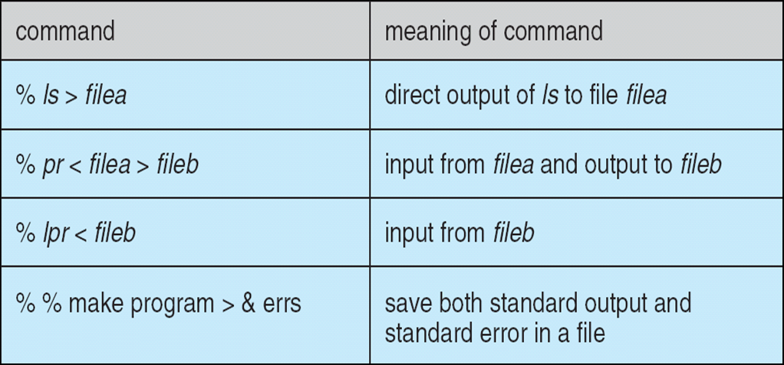
Standard I/O Redirection

Slide 26
Pipelines, Filters, and Shell Scripts
Can coalesce individual commands via a vertical bar that tells the shell to pass the previous command’s output as input to the following command % ls | pr | lpr
Filter – a command such as pr that passes its standard input to its standard output, performing some processing on it
Writing a new shell with a different syntax and semantics would change the user view, but not change the kernel or programmer interface
X Window System is a widely accepted iconic interface for UNIX

Slide 27
Process Management
Representation of processes is a major design problem for operating system
UNIX is distinct from other systems in that multiple processes can be created and manipulated with ease
These processes are represented in UNIX by various control blocks
Control blocks associated with a process are stored in the kernel
Information in these control blocks is used by the kernel for process control and CPU scheduling

Slide 28
Process Control Blocks
The most basic data structure associated with processes is the process structure
unique process identifier
scheduling information (e.g., priority)
pointers to other control blocks
The virtual address space of a user process is divided into text (program code), data, and stack segments
Every process with sharable text has a pointer form its process structure to a text structure
always resident in main memory
records how many processes are using the text segment
records were the page table for the text segment can be found on disk when it is swapped

Slide 29
System Data Segment
Most ordinary work is done in user mode; system calls are performed in system mode
The system and user phases of a process never execute simultaneously
A kernel stack (rather than the user stack) is used for a process executing in system mode
The kernel stack and the user structure together compose the system data segment for the process

Slide 30
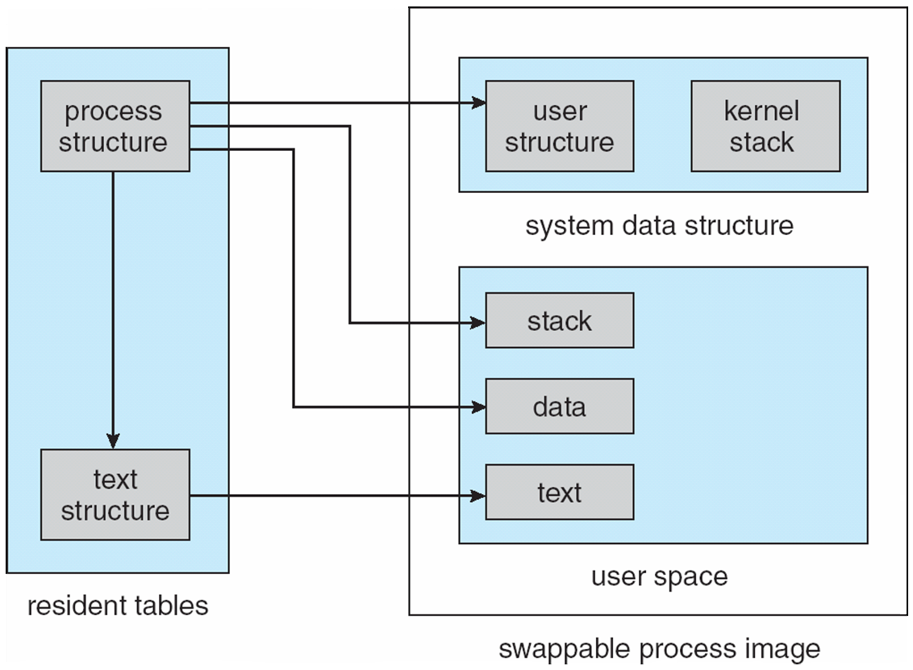
Finding parts of a process using process structure

Slide 31
Allocating a New Process Structure
Fork allocates a new process structure for the child process, and copies the user structure
new page table is constructed
new main memory is allocated for the data and stack segments of the child process
copying the user structure preserves open file descriptors, user and group identifiers, signal handling, etc.

Slide 32
Allocating a New Process Structure (Cont.)
vfork does not copy the data and stack to t he new process; the new process simply shares the page table of the old one
new user structure and a new process structure are still created
commonly used by a shell to execute a command and to wait for its completion
A parent process uses vfork to produce a child process; the child uses execve to change its virtual address space, so there is no need for a copy of the parent
Using vfork with a large parent process saves CPU time, but can be dangerous since any memory change occurs in both processes until execve occurs
execve creates no new process or user structure; rather the text and data of the process are replaced

Slide 33
CPU Scheduling
Every process has a scheduling priority associated with it; larger numbers indicate lower priority
Negative feedback in CPU scheduling makes it difficult for a single process to take all the CPU time
Process aging is employed to prevent starvation
When a process chooses to relinquish the CPU, it goes to sleep on an event
When that event occurs, the system process that knows about it calls wakeup with the address corresponding to the event, and all processes that had done a sleep on the same address are put in the ready queue to be run

Slide 34
Memory Management
The initial memory management schemes were constrained in size by the relatively small memory resources of the PDP machines on which UNIX was developed.
Pre 3BSD system use swapping exclusively to handle memory contention among processes: If there is too much contention, processes are swapped out until enough memory is available
Allocation of both main memory and swap space is done first-fit

Slide 35
Memory Management (Cont.)
Sharable text segments do not need to be swapped; results in less swap traffic and reduces the amount of main memory required for multiple processes using the same text segment.
The scheduler process (or swapper) decides which processes to swap in or out, considering such factors as time idle, time in or out of main memory, size, etc.

Slide 36
Paging
Berkeley UNIX systems depend primarily on paging for memory-contention management, and depend only secondarily on swapping.
Demand paging – When a process needs a page and the page is not there, a page fault tot he kernel occurs, a frame of main memory is allocated, and the proper disk page is read into the frame.
A pagedaemon process uses a modified second-chance page-replacement algorithm to keep enough free frames to support the executing processes.
If the scheduler decides that the paging system is overloaded, processes will be swapped out whole until the overload is relieved.

Slide 37
File System
The UNIX file system supports two main objects: files and directories.
Directories are just files with a special format, so the representation of a file is the basic UNIX concept.

Slide 38
Blocks and Fragments
Most of the file system is taken up by data blocks
4.2BSD uses two block sized for files which have no indirect blocks:
All the blocks of a file are of a large block size (such as 8K), except the last
The last block is an appropriate multiple of a smaller fragment size (i.e., 1024) to fill out the file
Thus, a file of size 18,000 bytes would have two 8K blocks and one 2K fragment (which would not be filled completely)

Slide 39
Blocks and Fragments (Cont.)
The block and fragment sizes are set during file-system creation according to the intended use of the file system:
If many small files are expected, the fragment size should be small
If repeated transfers of large files are expected, the basic block size should be large
The maximum block-to-fragment ratio is 8 : 1; the minimum block size is 4K (typical choices are 4096 : 512 and 8192 : 1024)

Slide 40
Inodes
A file is represented by an inode — a record that stores information about a specific file on the disk
The inode also contains 15 pointer to the disk blocks containing the file’s data contents
First 12 point to direct blocks
Next three point to indirect blocks
First indirect block pointer is the address of a single indirect block — an index block containing the addresses of blocks that do contain data
Second is a double-indirect-block pointer, the address of a block that contains the addresses of blocks that contain pointer to the actual data blocks.
A triple indirect pointer is not needed; files with as many as 232 bytes will use only double indirection

Slide 41
Directories
The inode type field distinguishes between plain files and directories
Directory entries are of variable length; each entry contains first the length of the entry, then the file name and the inode number
The user refers to a file by a path name,whereas the file system uses the inode as its definition of a file
The kernel has to map the supplied user path name to an inode
Directories are used for this mapping

Slide 42
Directories (Cont.)
First determine the starting directory:
If the first character is “/”, the starting directory is the root directory
For any other starting character, the starting directory is the current directory
The search process continues until the end of the path name is reached and the desired inode is returned
Once the inode is found, a file structure is allocated to point to the inode
4.3BSD improved file system performance by adding a directory name cache to hold recent directory-to-inode translations

Slide 43
Mapping of a File Descriptor to an Inode
System calls that refer to open files indicate the file is passing a file descriptor as an argument
The file descriptor is used by the kernel to index a table of open files for the current process
Each entry of the table contains a pointer to a file structure
This file structure in turn points to the inode
Since the open file table has a fixed length which is only setable at boot time, there is a fixed limit on the number of concurrently open files in a system

Slide 44
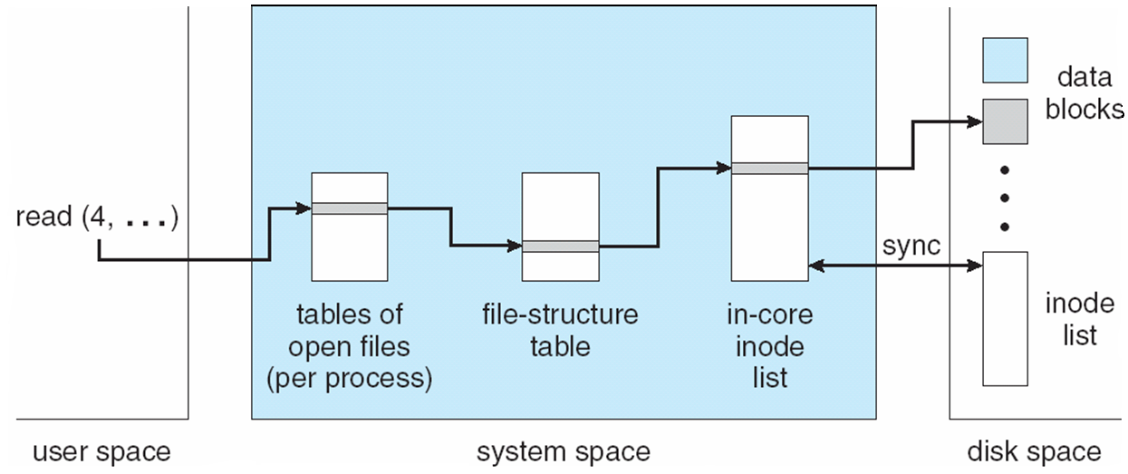
File-System Control Blocks

Slide 45
Disk Structures
The one file system that a user ordinarily sees may actually consist of several physical file systems, each on a different device
Partitioning a physical device into multiple file systems has several benefits
Different file systems can support different uses
Reliability is improved
Can improve efficiency by varying file-system parameters
Prevents one program form using all available space for a large file
Speeds up searches on backup tapes and restoring partitions from tape

Slide 46
Disk Structures (Cont.)
The root file system is always available on a drive
Other file systems may be mounted — i.e., integrated into the directory hierarchy of the root file system
The following figure illustrates how a directory structure is partitioned into file systems, which are mapped onto logical devices, which are partitions of physical devices

Slide 47
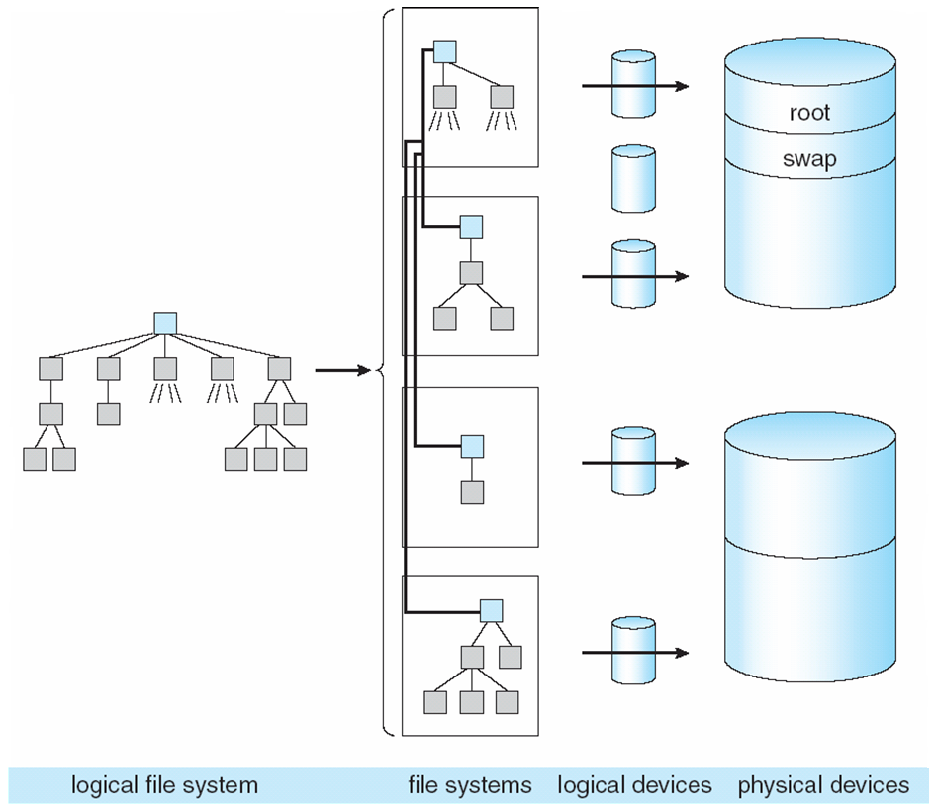
Mapping File System to Physical Devices

Slide 48
Implementations
The user interface to the file system is simple and well defined, allowing the implementation of the file system itself to be changed without significant effect on the user
For Version 7, the size of inodes doubled, the maximum file and file system sized increased, and the details of free-list handling and superblock information changed
In 4.0BSD, the size of blocks used in the file system was increased form 512 bytes to 1024 bytes — increased internal fragmentation, but doubled throughput
4.2BSD added the Berkeley Fast File System, which increased speed, and included new features
New directory system calls
truncate calls
Fast File System found in most implementations of UNIX

Slide 49
Layout and Allocation Policy
The kernel uses a <logical device number, inode number> pair to identify a file
The logical device number defines the file system involved
The inodes in the file system are numbered in sequence
4.3BSD introduced the cylinder group — allows localization of the blocks in a file
Each cylinder group occupies one or more consecutive cylinders of the disk, so that disk accesses within the cylinder group require minimal disk head movement
Every cylinder group has a superblock, a cylinder block, an array of inodes, and some data blocks

Slide 50
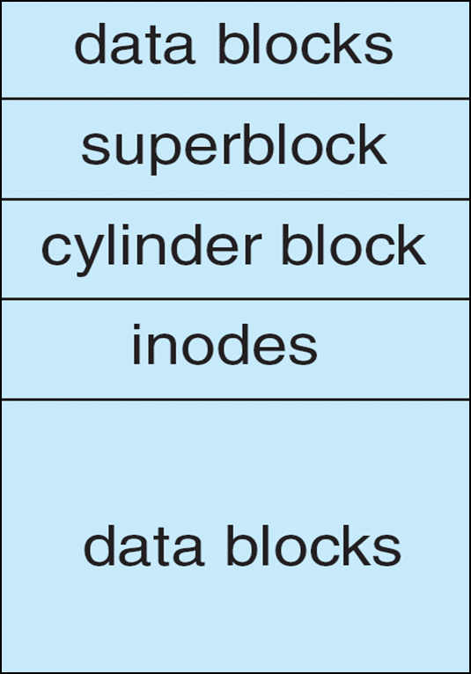
4.3BSD Cylinder Group

Slide 51
I/O System
The I/O system hides the peculiarities of I/O devices from the bulk of the kernel
Consists of a buffer caching system, general device driver code, and drivers for specific hardware devices
Only the device driver knows the peculiarities of a specific device

Slide 52
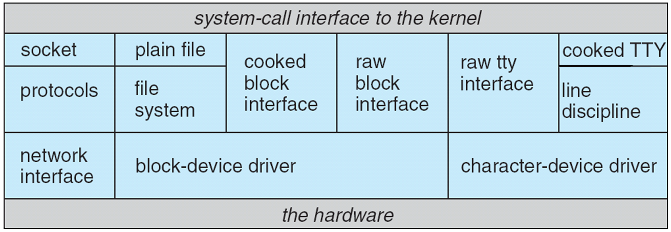
4.3 BSD Kernel I/O Structure

Slide 53
Block Buffer Cache
Consist of buffer headers, each of which can point to a piece of physical memory, as well as to a device number and a block number on the device.
The buffer headers for blocks not currently in use are kept in several linked lists:
Buffers recently used, linked in LRU order (LRU list)
Buffers not recently used, or without valid contents (AGE list)
EMPTY buffers with no associated physical memory
When a block is wanted from a device, the cache is searched.
If the block is found it is used, and no I/O transfer is necessary.
If it is not found, a buffer is chosen from the AGE list, or the LRU list if AGE is empty.

Slide 54
Block Buffer Cache (Cont.)
Buffer cache size effects system performance; if it is large enough, the percentage of cache hits can be high and the number of actual I/O transfers low.
Data written to a disk file are buffered in the cache, and the disk driver sorts its output queue according to disk address — these actions allow the disk driver to minimize disk head seeks and to write data at times optimized for disk rotation.

Slide 55
Raw Device Interfaces
Almost every block device has a character interface, or raw device interface — unlike the block interface, it bypasses the block buffer cache.
Each disk driver maintains a queue of pending transfers.
Each record in the queue specifies:
whether it is a read or a write
a main memory address for the transfer
a device address for the transfer
a transfer size
It is simple to map the information from a block buffer to what is required for this queue.

Slide 56
C-Lists
Terminal drivers use a character buffering system which involves keeping small blocks of characters in linked lists.
A write system call to a terminal enqueues characters on a list for the device. An initial transfer is started, and interrupts cause dequeueing of characters and further transfers.
Input is similarly interrupt driven
It is also possible to have the device driver bypass the canonical queue and return characters directly form the raw queue — raw mode (used by full-screen editors and other programs that need to react to every keystroke).

Slide 57
Interprocess Communication
The pipe is the IPC mechanism most characteristic of UNIX
Permits a reliable unidirectional byte stream between two processes
A benefit of pipes small size is that pipe data are seldom written to disk; they usually are kept in memory by the normal block buffer cache
In 4.3BSD, pipes are implemented as a special case of the socket mechanism which provides a general interface not only to facilities such as pipes, which are local to one machine, but also to networking facilities.
The socket mechanism can be used by unrelated processes.

Slide 58
Sockets
A socket is an endpont of communication.
An in-use socket it usually bound with an address; the nature of the address depends on the communication domain of the socket.
A characteristic property of a domain is that processes communication in the same domain use the same address format.
A single socket can communicate in only one domain — the three domains currently implemented in 4.3BSD are:
the UNIX domain (AF_UNIX)
the Internet domain (AF_INET)
the XEROX Network Service (NS) domain (AF_NS)

Slide 59
Socket Types
Stream sockets provide reliable, duplex, sequenced data streams. Supported in Internet domain by the TCP protocol. In UNIX domain, pipes are implemented as a pair of communicating stream sockets.
Sequenced packet sockets provide similar data streams, except that record boundaries are provided
Used in XEROX AF_NS protocol
Datagram sockets transfer messages of variable size in either direction. Supported in Internet domain by UDP protocol.
Reliably delivered message sockets transfer messages that are guaranteed to arrive (Currently unsupported).
Raw sockets allow direct access by processes to the protocols that support the other socket types; e.g., in the Internet domain, it is possible to reach TCP, IP beneath that, or a deeper Ethernet protocol
Useful for developing new protocols

Slide 60
Socket System Calls
The socket call creates a socket; takes as arguments specifications of the communication domain, socket type, and protocol to be used and returns a small integer called a socket descriptor.
A name is bound to a socket by the bind system call.
The connect system call is used to initiate a connection.
A server process uses socket to create a socket and bind to bind the well-known address of its service to that socket
Uses listen to tell the kernel that it is ready to accept connections from clients
Uses accept to accept individual connections
Uses fork to produce a new process after the accept to service the client while the original server process continues to listen for more connections

Slide 61
Socket System Calls (Cont.)
The simplest way to terminate a connection and to destroy the associated socket is to use the close system call on its socket descriptor.
The select system call can be used to multiplex data transfers on several file descriptors and /or socket descriptors.

Slide 62
Network Support
Networking support is one of the most important features in 4.3BSD.
The socket concept provides the programming mechanism to access other processes, even across a network.
Sockets provide an interface to several sets of protocols.
Almost all current UNIX systems support UUCP.
4.3BSD supports the DARPA Internet protocols UDP, TCP, IP, and ICMP on a wide range of Ethernet, token-ring, and ARPANET interfaces.
The 4.3BSD networking implementation, and to a certain extent the socket facility, is more oriented toward the ARPANET Reference Model (ARM).

Slide 63
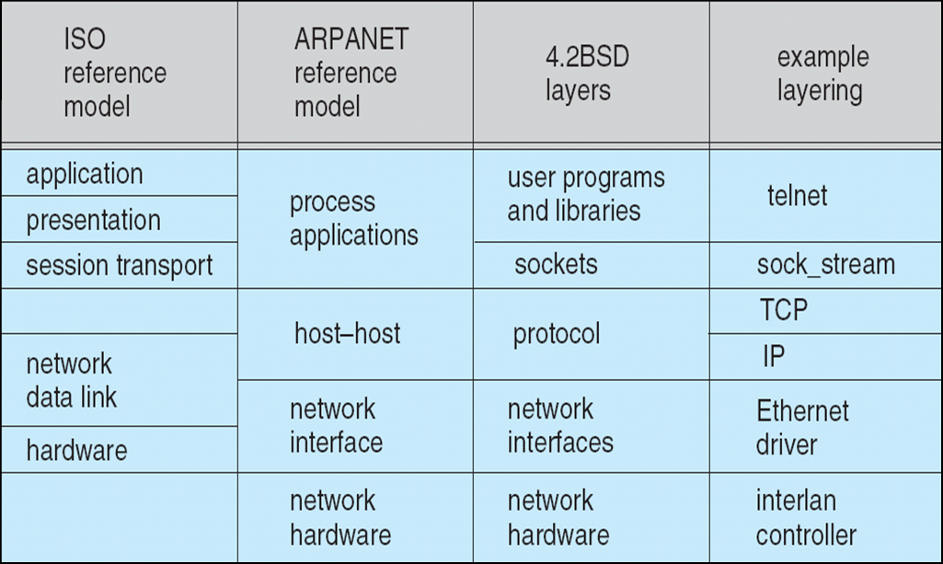
Network Reference models and Layering

Slide 64
End of Appendix A

